Slide 1

Basic Details of Problem Statement and Team
Problem Statement Title:: Developing a website that Helps track and Monitor illegal activities on the Dark Web.
Team Name: Cod-O-Maniacs
Team Leader Name: Vishu Bhati
Registration ID: 1773
Institute Name: Poornima College Of Engineering , Jaipur
Theme Name: Dark Web Monitoring
Monitor

Slide 2




Our Esteemed Team Members and their roles
Vishu Bhati
(Team Leader) Role – Presenter
Programmer
Kumar Vatsalya Rahul Role – Presentation Creator
Sahil Agarwal Role – Content Creator
Nityam Kumar Role – Website Interface Creator

Slide 3
Points Covered
Dark Web Characteristics
Data Leak Recovery
Threat Intelligence and Analysis
Integration with Incident Response and cyber security infrastructure
Why Monitor the Dark Web?
Idea/Approach Details
Working on our website “Pro-Tekk”
Software and Programming Language Used
Future Plans

Slide 4

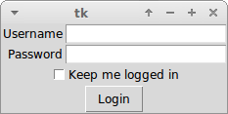


Dark Web Characteristics
Protected by authentication layer or paywall
Not referenced by search engines whatsoever
Not linked from other pages.

Slide 5

Data Leak Recovery
It is important to seek the help of dark web experts when dealing with cyber threats such as stolen passwords, credit card numbers, or confidential information. Attempting to go after cyber criminals on your own can be risky, so it is recommended to find a reputable cyber-security provider with experienced dark web analysts to handle the situation.

Slide 6

Threat Intelligence and
Analysis
Digital threats require a reliable strategy for threat intelligence and analysis. Good monitoring should provide analyzed data on digital threat actors and emerging threats. Dark web threat intelligence is critical, as it's a hub for cybercrime. Reliable cyber threat intelligence can provide early warning of threats and help find mentions of your brand, locations, and people. Good cyber threat intelligence speeds up decision-making for security leaders, making a monitoring tool invaluable.
This Photo by Unknown Author is licensed under CC BY-SA-NC

Slide 7

Cybersecurity Integration
When selecting a Dark Web monitoring solution, consider its ability to integrate with existing security architecture. The more integrations and partnerships, the higher the chances of success. An effective monitoring tool should provide end-to-end results for incident response and enable a quick and decisive counteraction, reducing both cost and impact.

Slide 8
Why Monitor Dark Web ?
Dark web is the home to many illegal activities such as Cybercrime , Drug dealing , Arms dealing , Money Laundering , cryptocurrency frauds, censorship resistance , etc. Many Crime Syndicates openly use dark web to let their crimes run wild over a full throttle since they know that it’s not easy to enter dark web. It’s extremely infuriating to see such crimes run wild. So, in order to stop these crimes once and for all , it gives rise to the dark web monitoring. Dark web monitoring, also known as Cyber-Monitoring, is a service that searches the dark web for stolen user credentials and personal and financial data available on the web. It uses automated scanners, crawlers, and scrapers to locate stolen credentials on public sites.

Slide 9
Idea / Approach Details
The dark web is part of
internet that isn't visible to search engines and requires the use of an anonymizing browser called Tor to be accessed. So, in order to resolve these problems and reducing crime-rates , We are creating a website to track and monitor the activities of Dark web which will track the IP address of the logged in devices and also track the location of every single device that has entered the dark web.

Slide 10
Working of Our Website “ Pro-Tekk”
1.) First , the government can visit our website by typing the URL --> www.pro-tekk.gov.in , since we’ll link our website with our government website.
2.) After that , You’ll be directed inside the interface of Dark web as we’ll directly link dark web with our website to remove the hassle of entering dark web. 3.) Then , on the same interface , you’ll get different types of buttons like Track IP address of logged-in devices , Logged-in devices , Location of Logged-in devices. 4.) You can choose any of the operations to track the devices using dark web in respective manner.

Slide 11
Software and Programming Languages
used
Frame Work → HTML Tracking → IP address and Device Location Monitoring → Device Location , Python

Slide 12
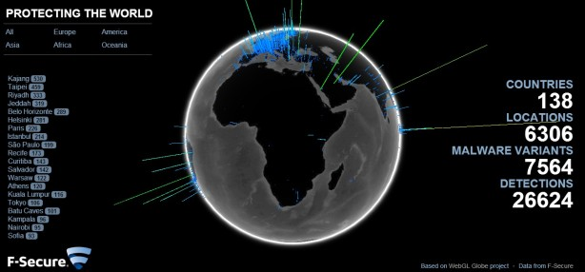
Future Plans
Our future plans for this website is to attain the ability to track the devices with changing IP address by using the last location of the device and the next location and noting the difference of the distance between following locations of the device and also using the time duration of the previous and the next IP address.

Slide 13
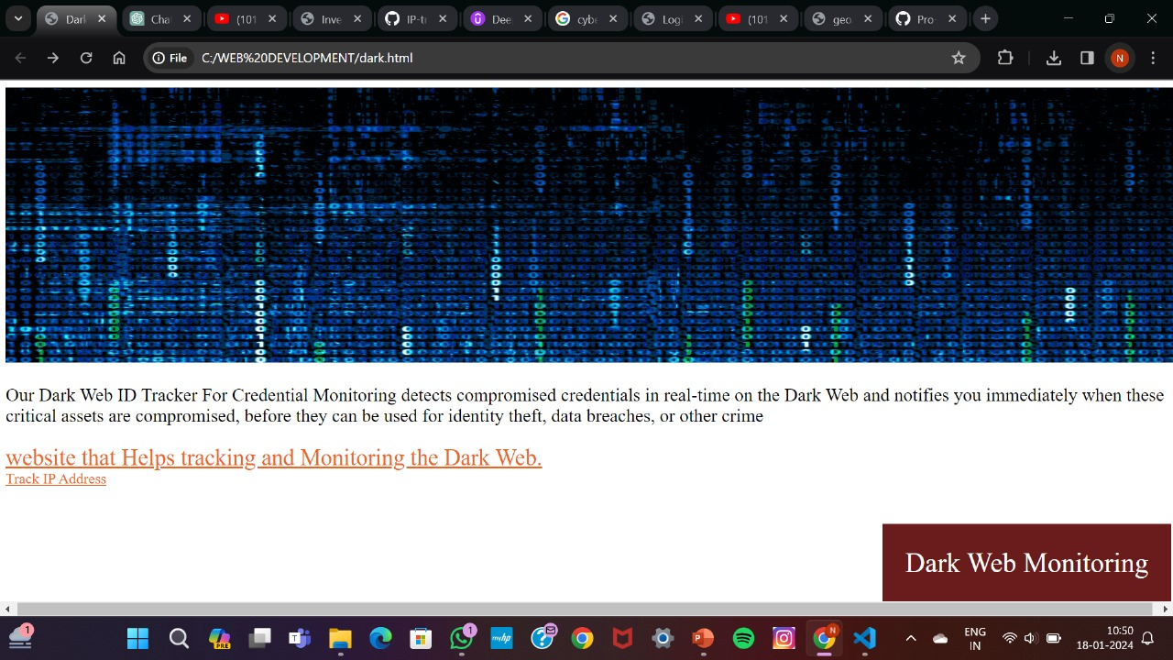
Sample Interface of “Pro-Tekk”

Slide 14


Code-O-Maniacs
vb6024727@gmail.com
+91 7357130627 +91 8434843998

Slide 15

THANK YOU

